Slide 1

Python
Group session #2

Slide 2
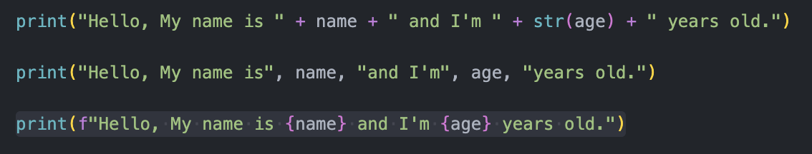
f-string
Makes string interpolation simpler!

Slide 3
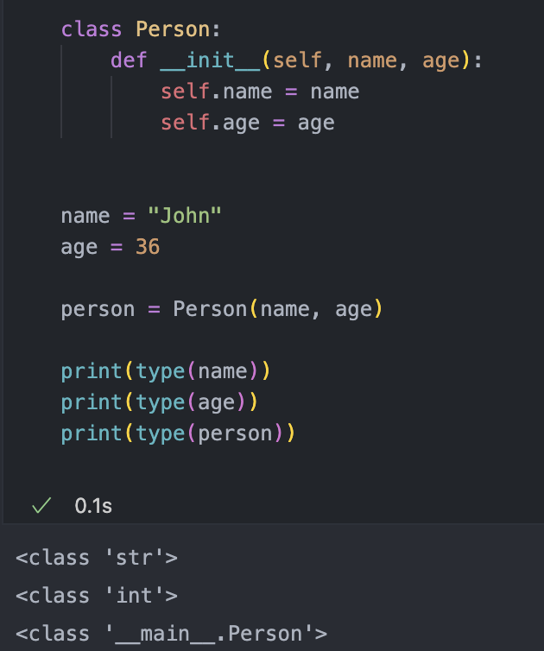
Check type() of variable isinstance(a, b) checks if a is of type b.

Slide 4
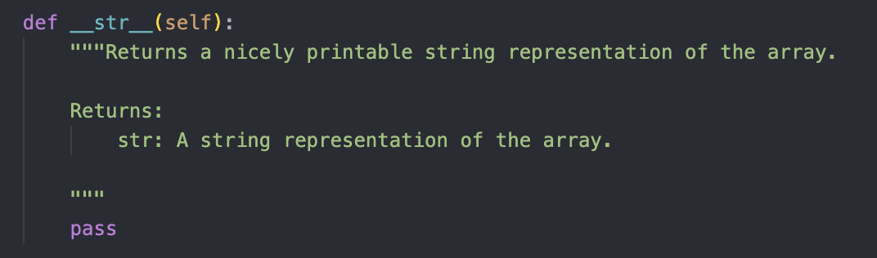
ALWAYS add docstring to a function!!!

Slide 5

Object-oriented programming (OOP)
Idea: Stores data and code in “objects”.
Usually class-based.
Classes and objects were introduced by Simula 67 by Ole-Johan Dahl and Kristen Nygaard.
class
object a
object b
object c

Slide 6






<class '__main__.Dog'>
Different “Dog objects”

Slide 7
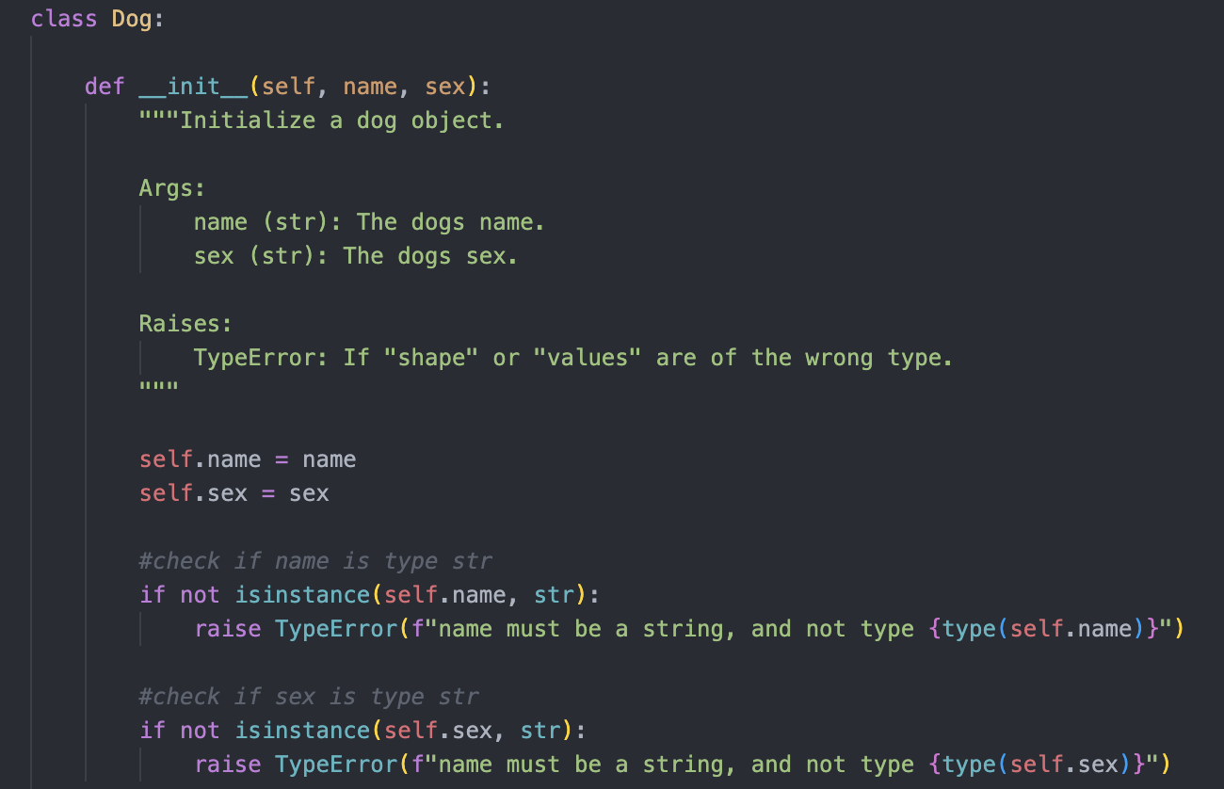

Slide 8
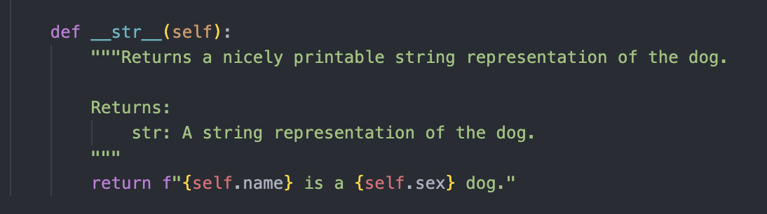
Dunder Methods
Dunder means “Double Under (Underscores)”
Also called “magic methods”

Slide 9
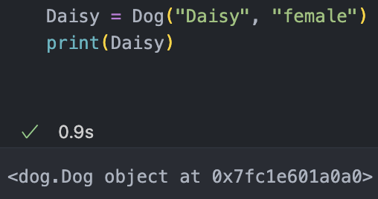
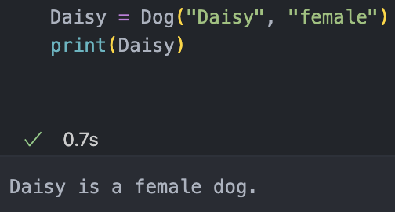
Without __str()__:
With __str()__:

Slide 10
__add__ vs __radd__
We have: x + y
Python first tries to call the left object’s __add__() method x.__add__(y). But this may fail for two reasons:
The method x.__add__() is not implemented in the first place,
The method x.__add__() is implemented but returns a NotImplemented value indicating that the data types are incompatible.
If this fails, Python tries to fix it by calling the y.__radd__() for reverse addition on the right operand y.

Slide 11
Unit tests
Identify a unit in your program that should have a well-defined behavior given a certain input. A unit can be a:
function
module
entire program
Write a test function that calls this input and checks that the output/behavior is as expected.
The more, the better! Preferably on several levels (function/module/program).
Use a test framework like py.test and checks like assert

Slide 12
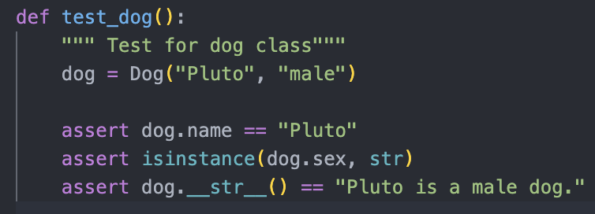
Unit tests

Slide 13
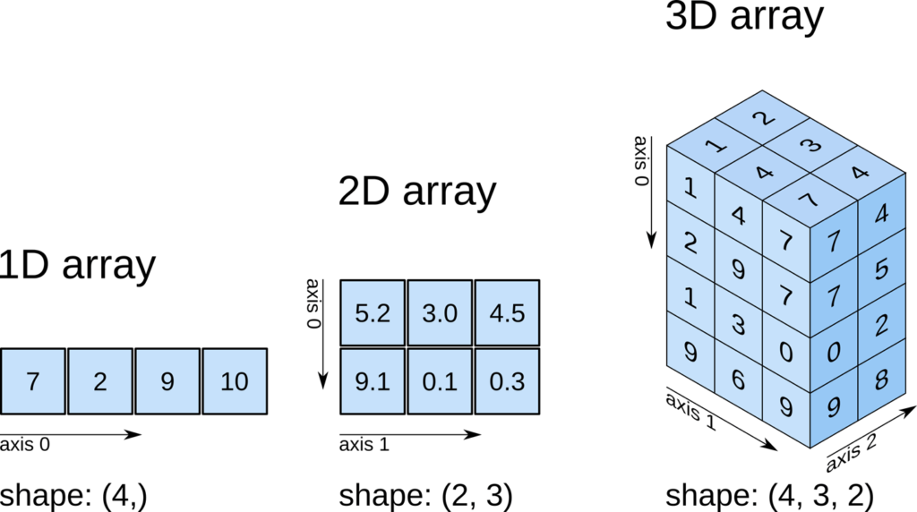
Arrays
https://www.pythontutorial.net/python-numpy/what-is-numpy/

